Slide 1

Chapter 15

Slide 2
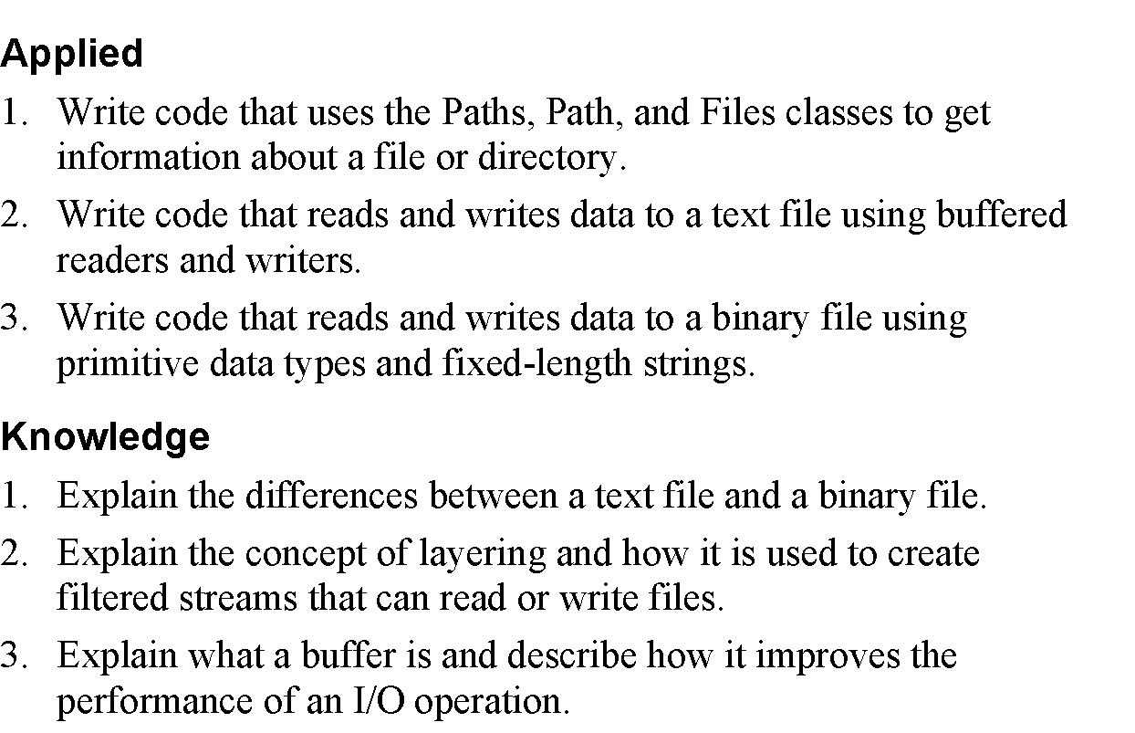
Objectives

Slide 3
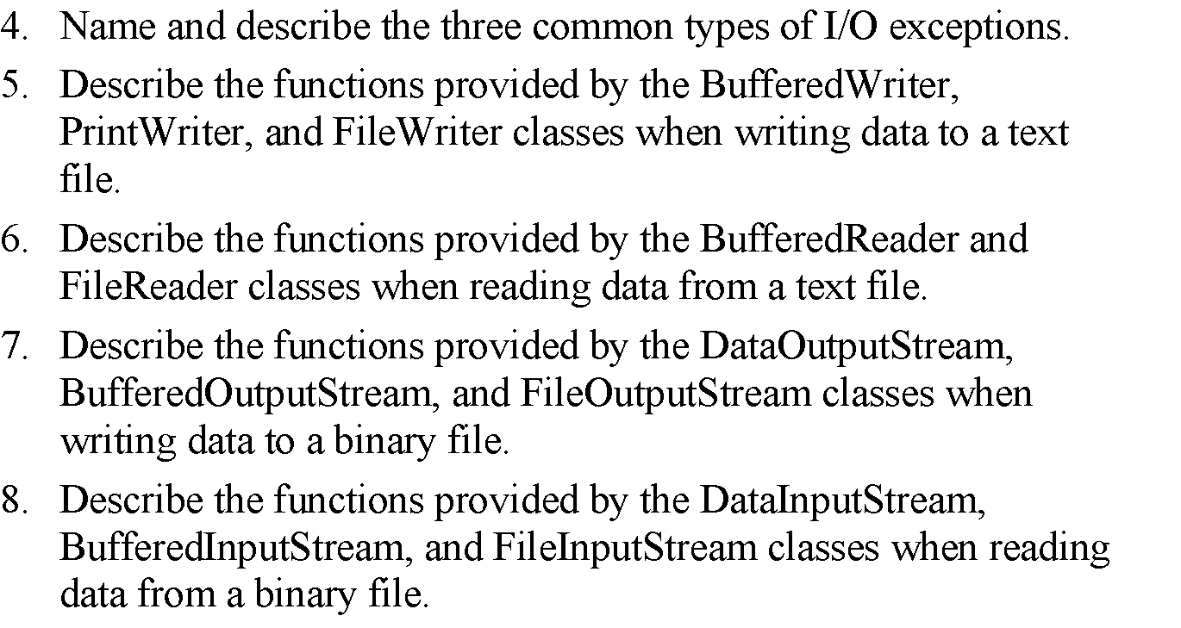
Objectives (cont.)

Slide 4
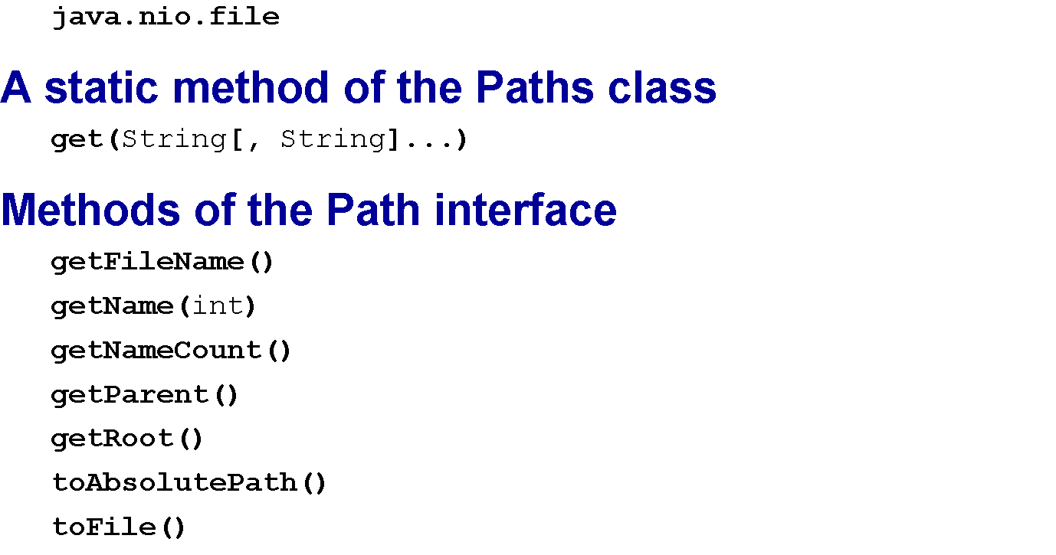
A package for working with directories and files

Slide 5
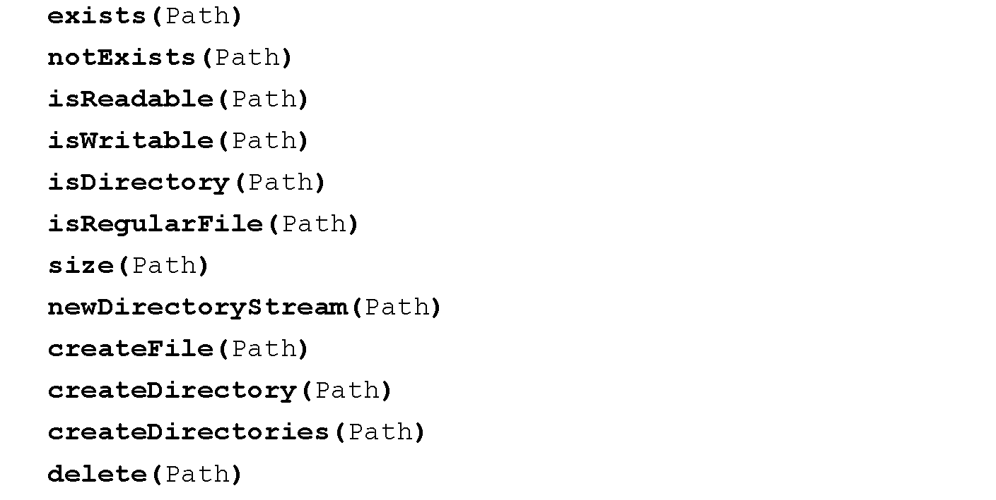
Static methods of the Files class

Slide 6
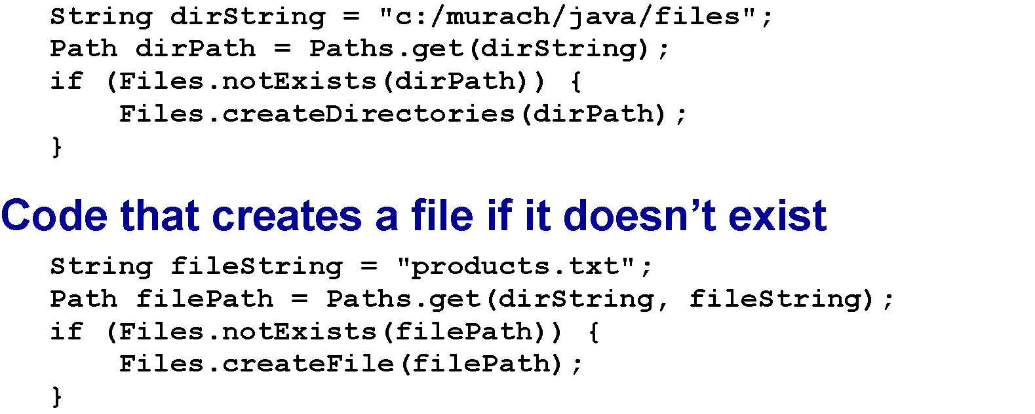
Code that creates a directory if it doesn’t exist

Slide 7
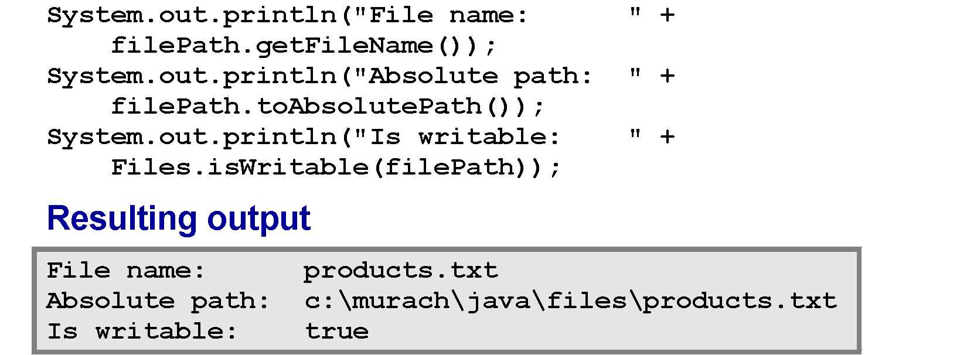
Code that displays information about a file

Slide 8
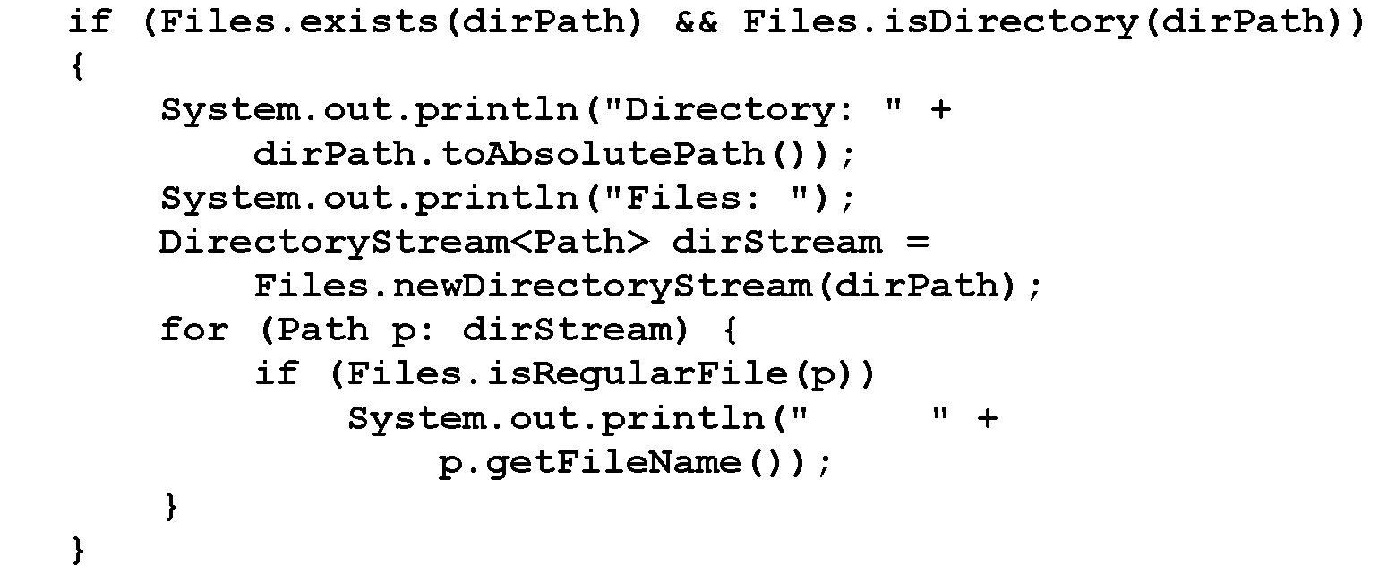
Code that displays the files in a directory

Slide 9
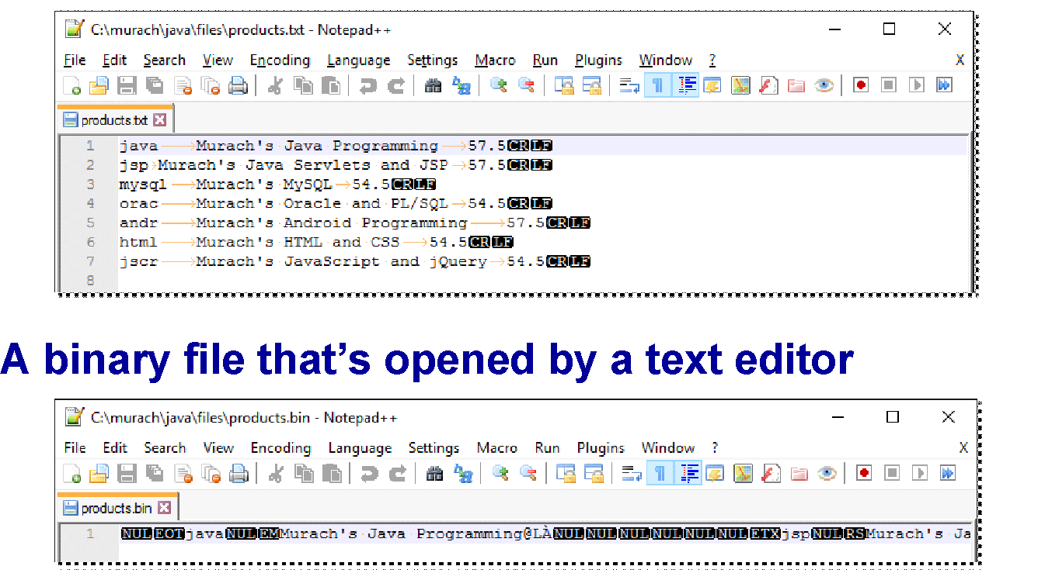
A text file that’s opened by a text editor

Slide 10
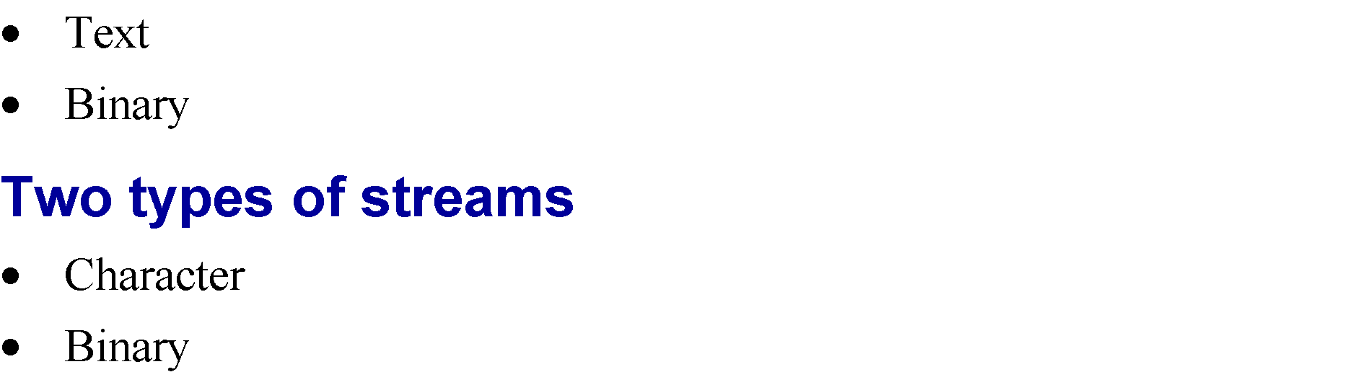
Two types of files

Slide 11
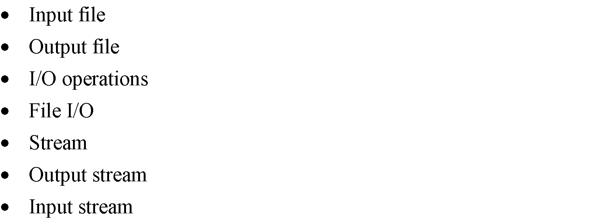
Terms

Slide 12
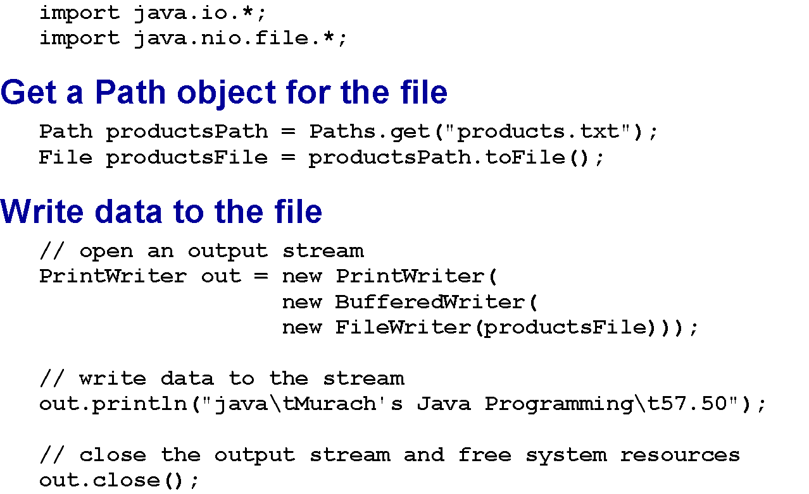
Import all necessary packages

Slide 13
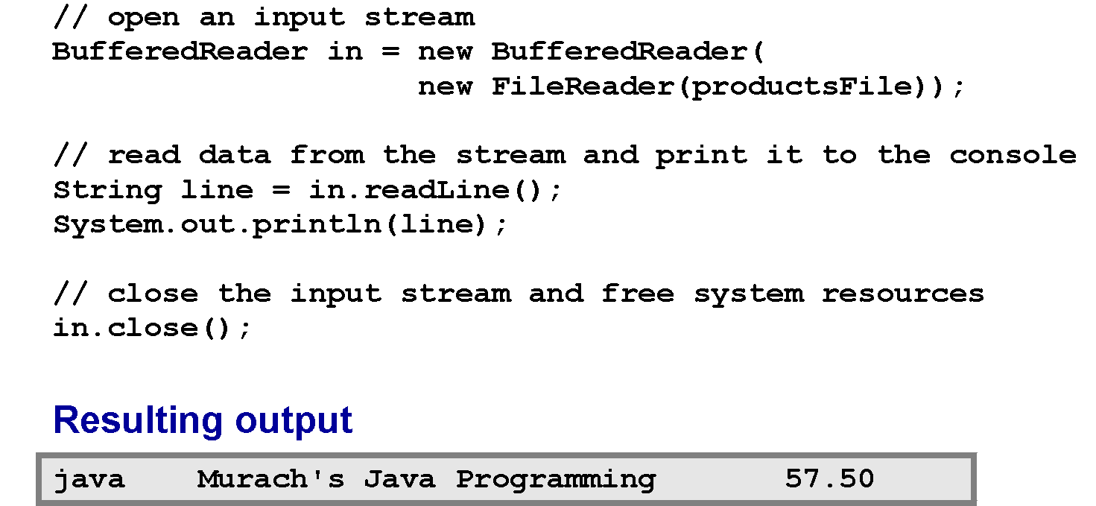
Read data from the file

Slide 14
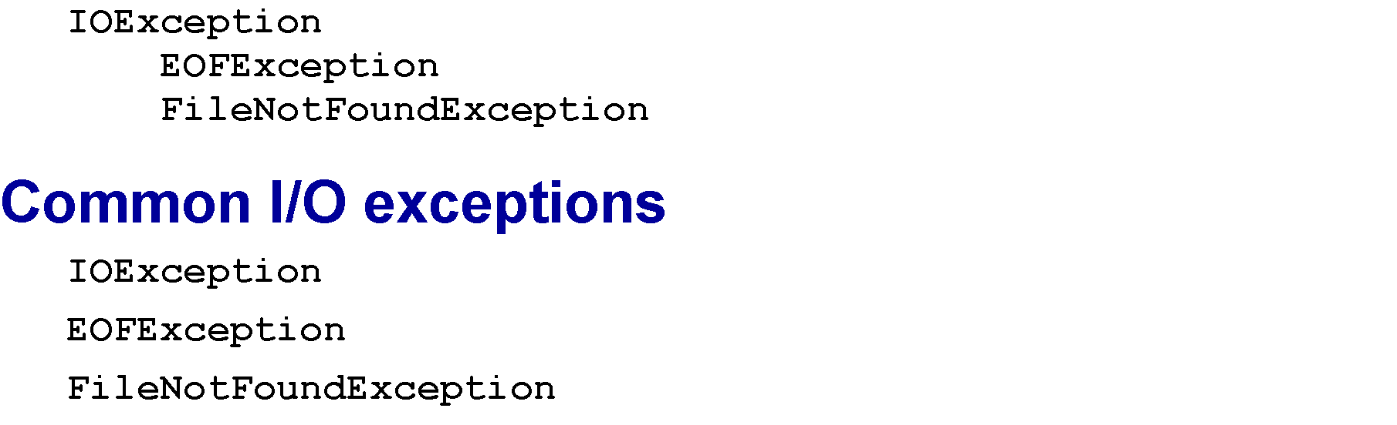
A subset of the IOException hierarchy

Slide 15
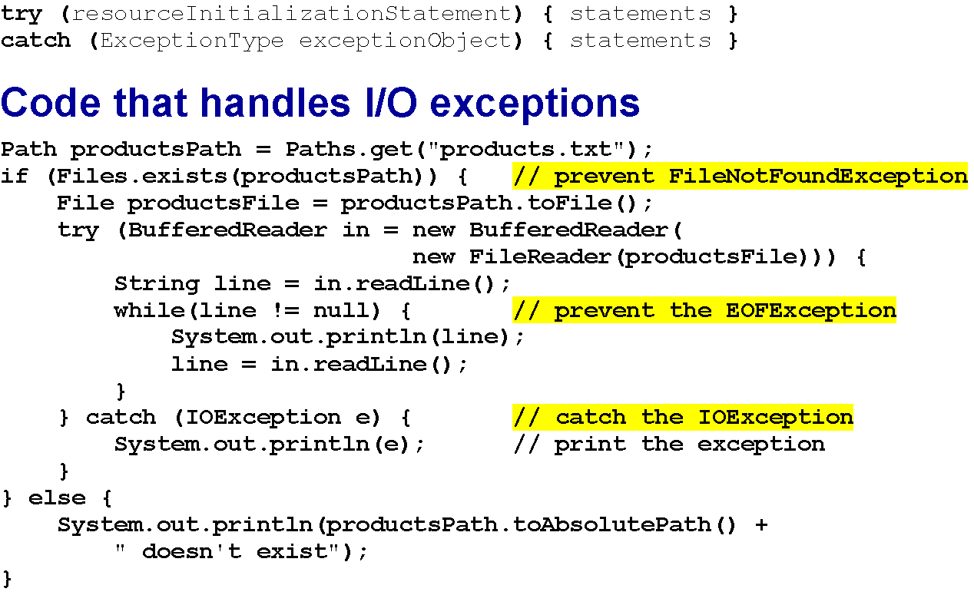
The syntax for a try-with-resources statement

Slide 16
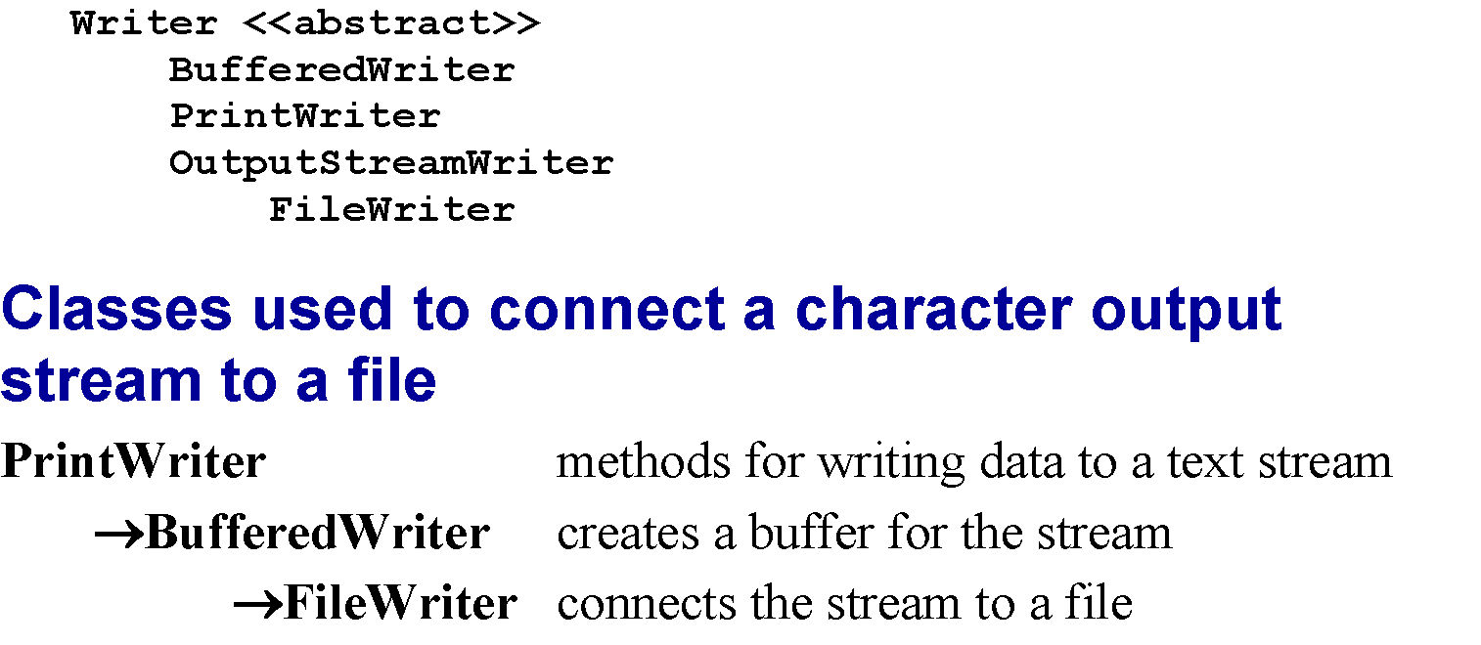
A subset of the Writer hierarchy

Slide 17
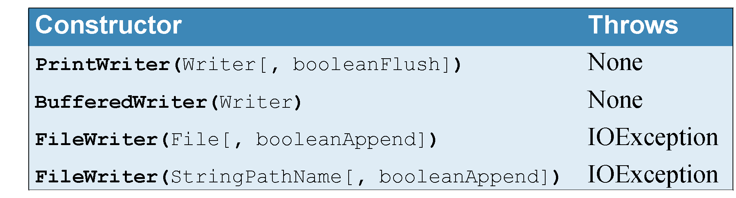
Constructors of the Writer hierarchy classes

Slide 18
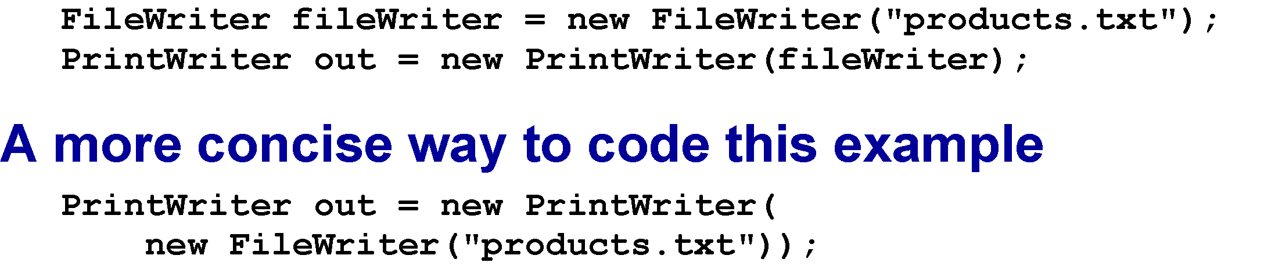
How to connect without a buffer (not recommended)

Slide 19
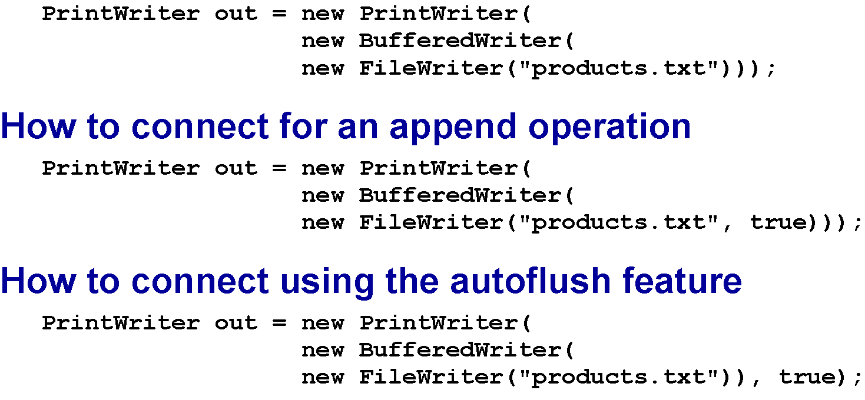
How to connect to a file with a buffer

Slide 20
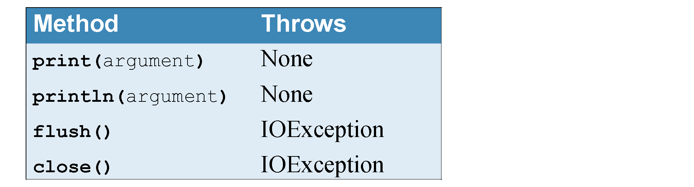
Common methods of the PrintWriter class

Slide 21
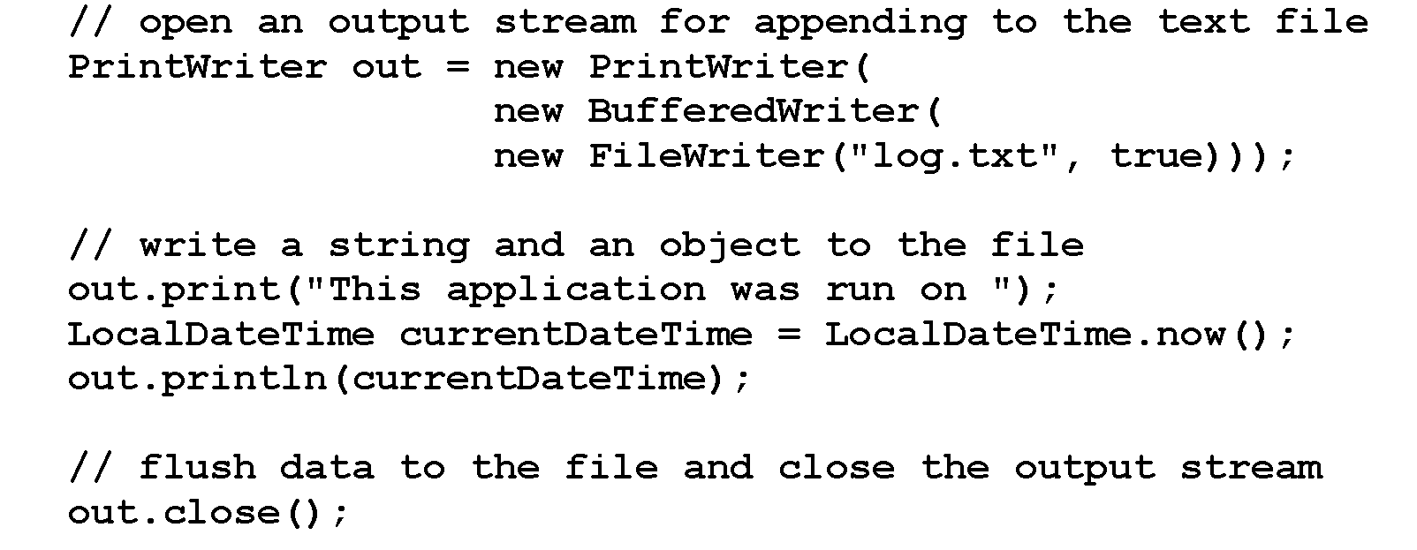
Code that appends a string and an object to a text file

Slide 22
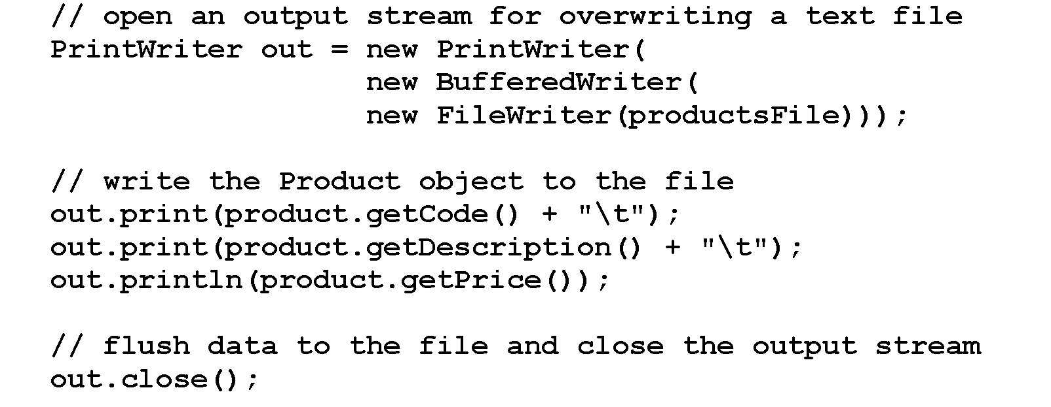
Code that writes a Product object to a delimited text file

Slide 23
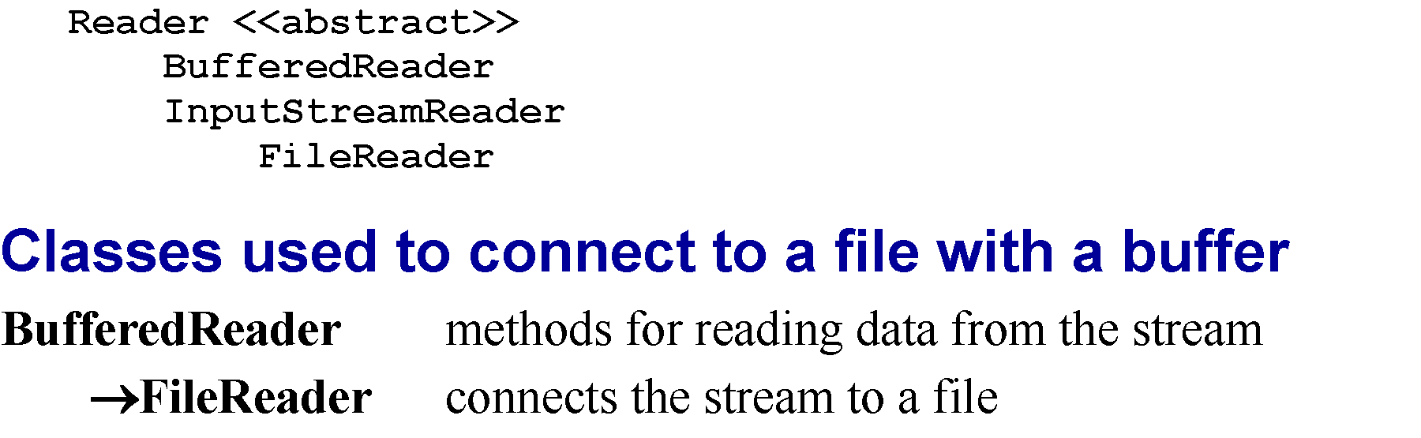
A subset of the Reader hierarchy

Slide 24
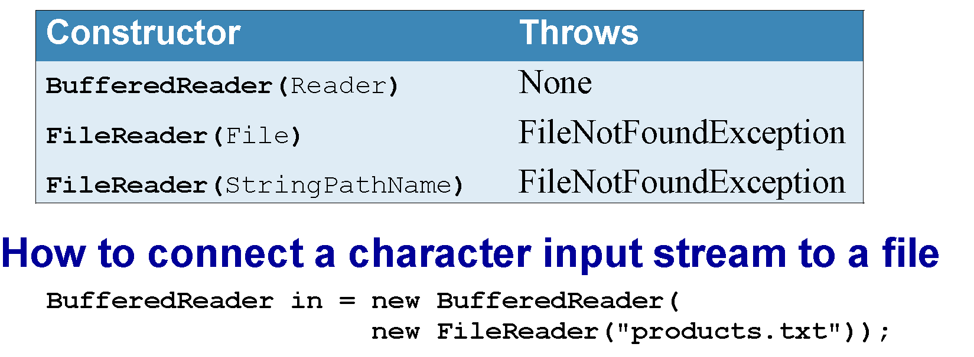
Constructors of the Reader hierarchy classes

Slide 25
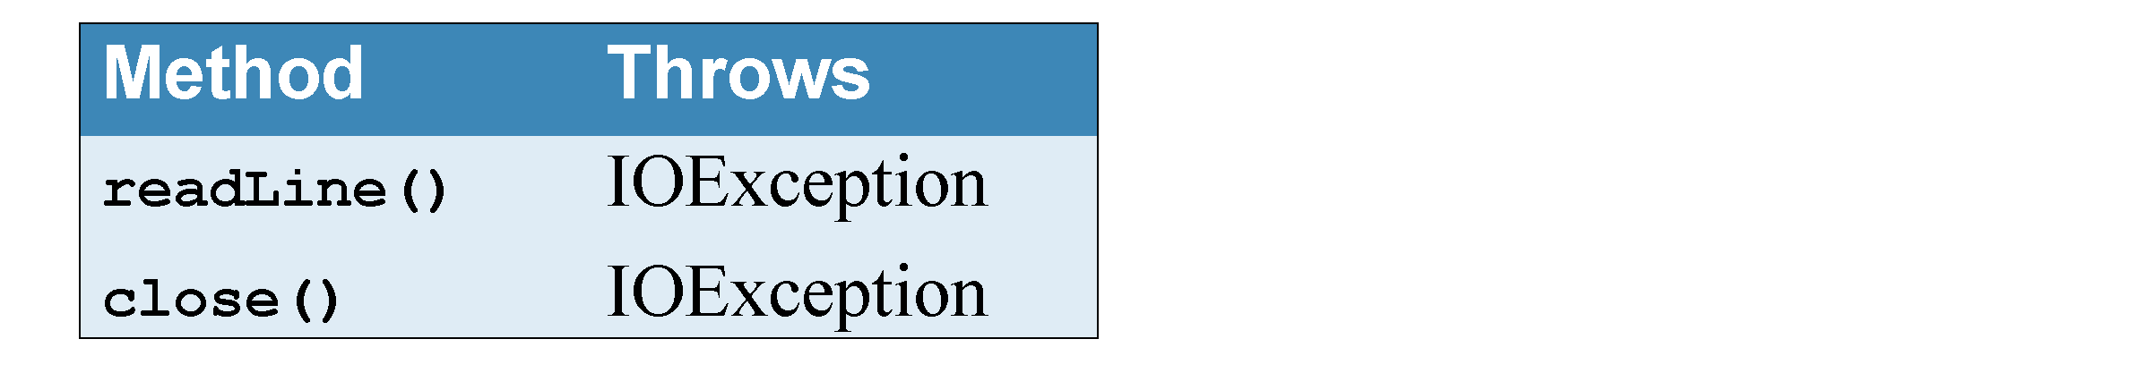
Common methods of the BufferedReader class

Slide 26
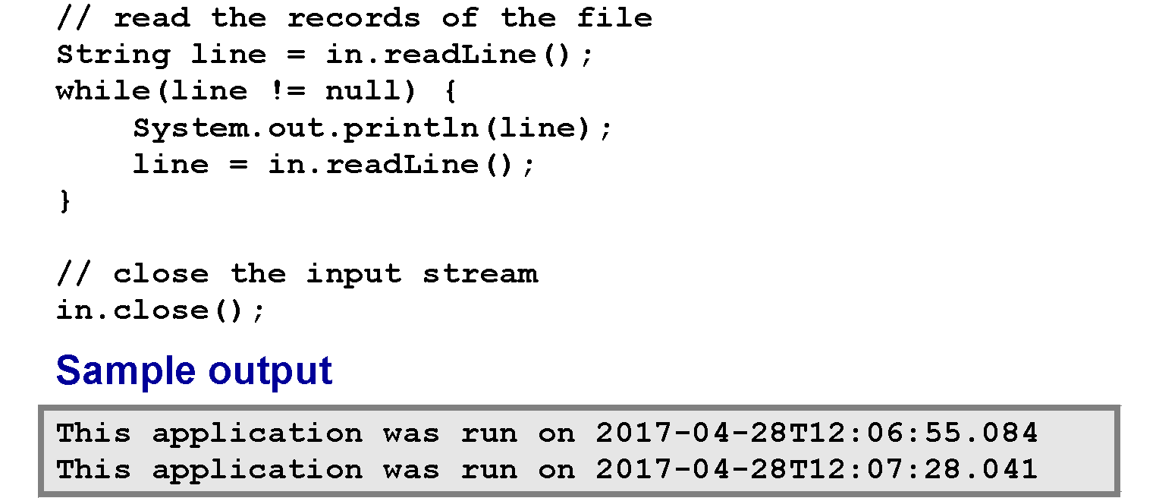
Code that reads the records in a text file

Slide 27
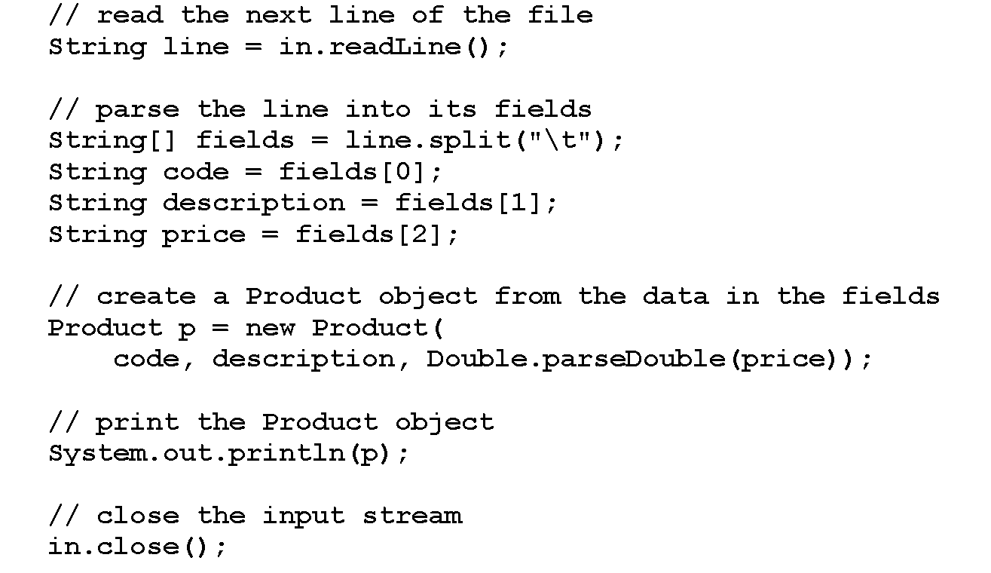
Code that reads a Product object from a delimited text file

Slide 28

Sample output from the delimited text file

Slide 29
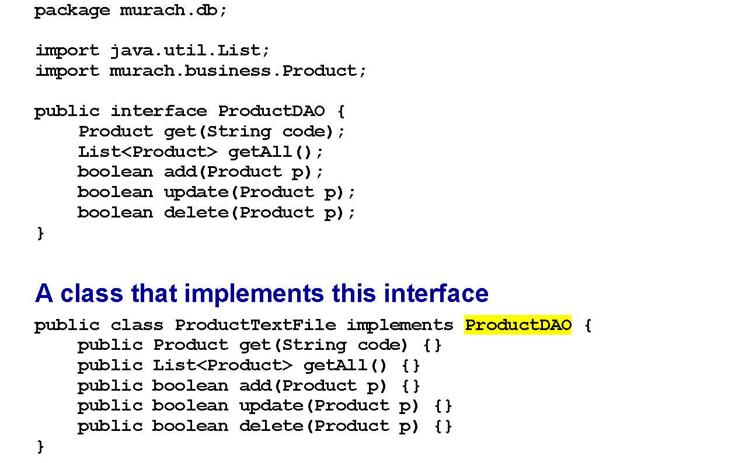
The ProductDAO interface

Slide 30
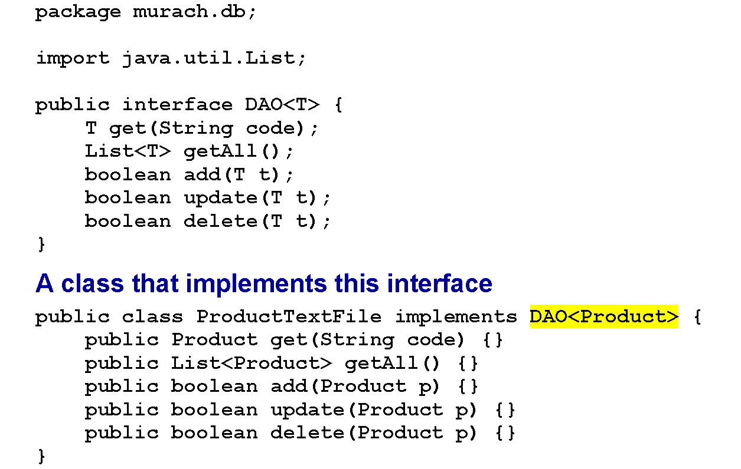
The DAO interface

Slide 31
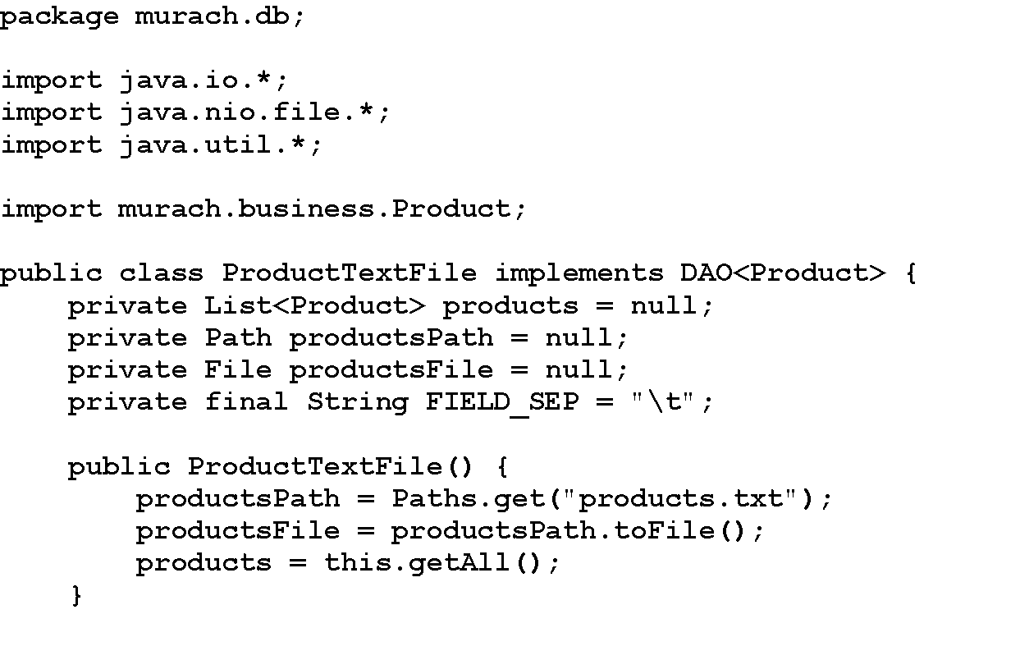
The ProductTextFile class

Slide 32
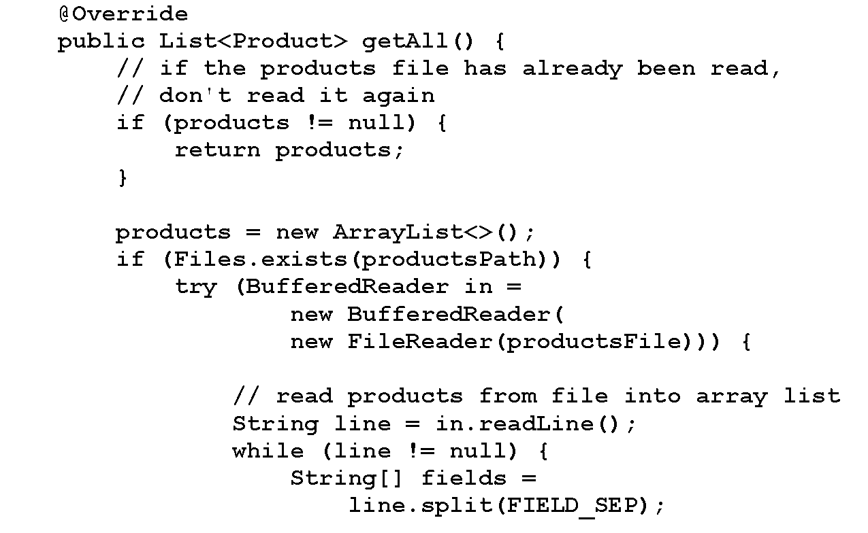
The ProductTextFile class (cont.)

Slide 33
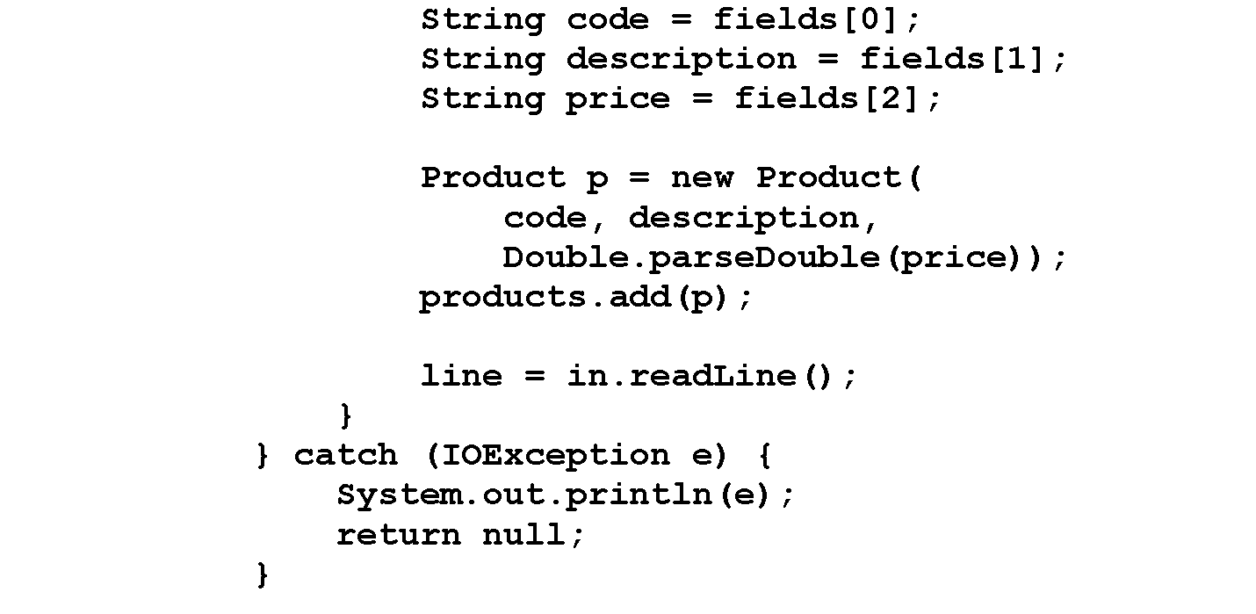
The ProductTextFile class (cont.)

Slide 34
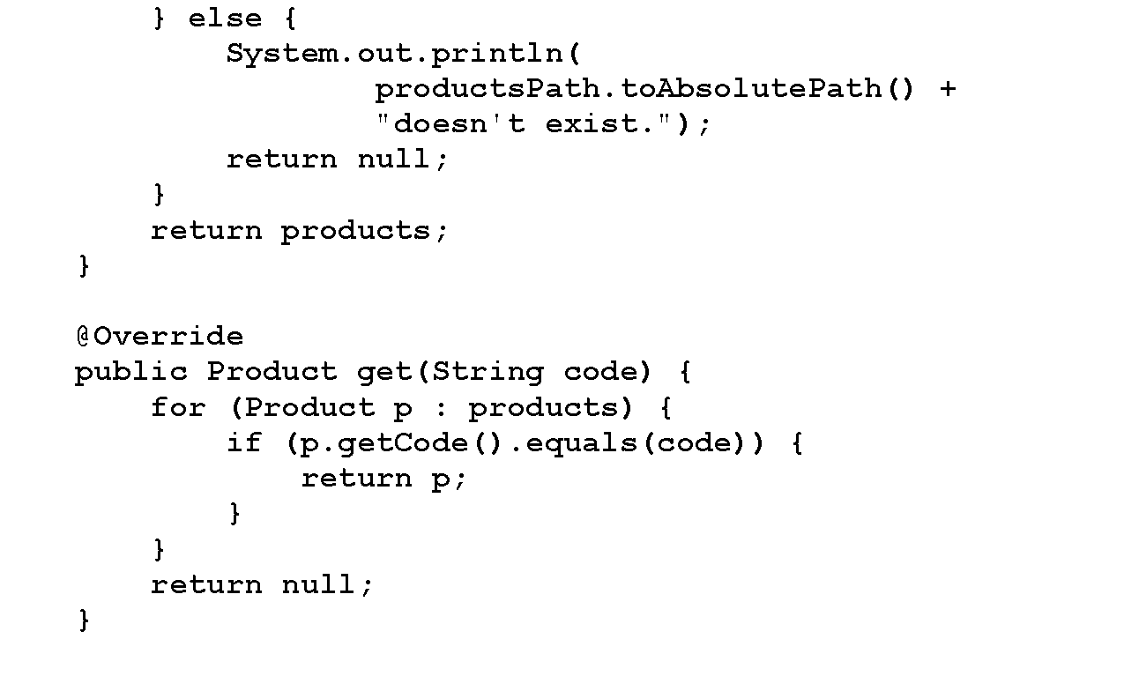
The ProductTextFile class (cont.)

Slide 35
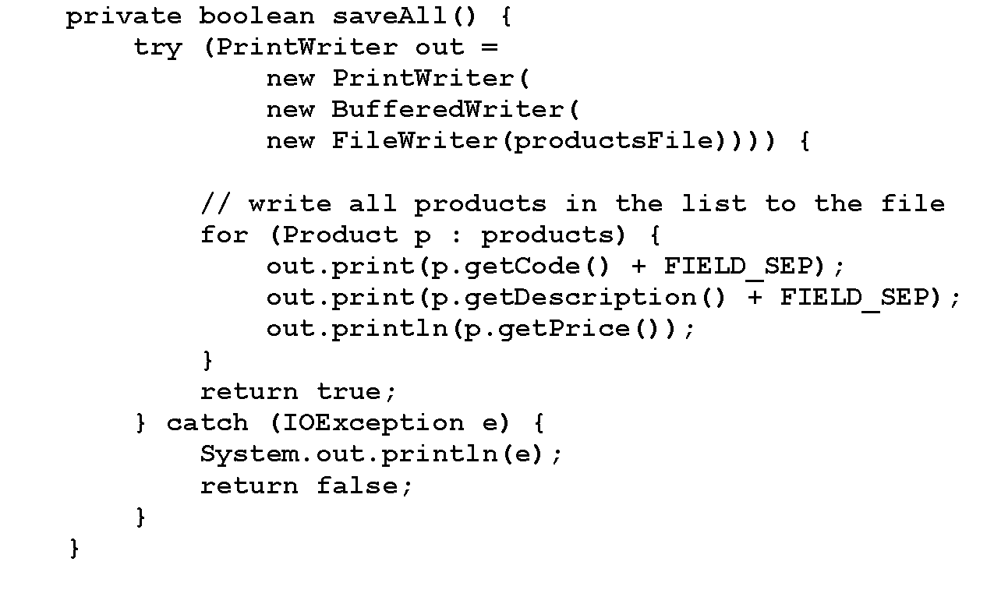
The ProductTextFile class (cont.)

Slide 36
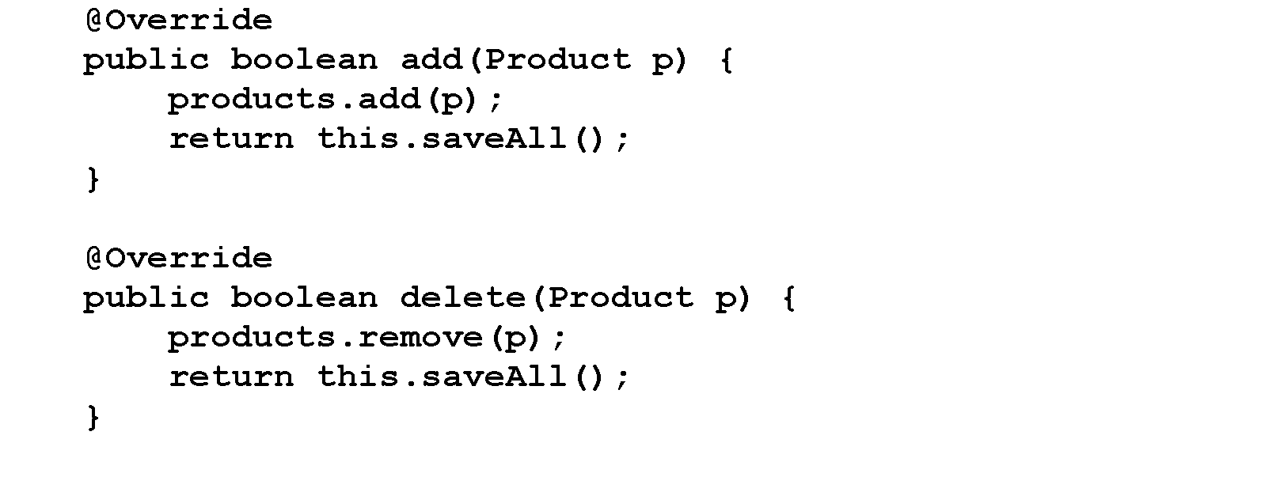
The ProductTextFile class (cont.)

Slide 37
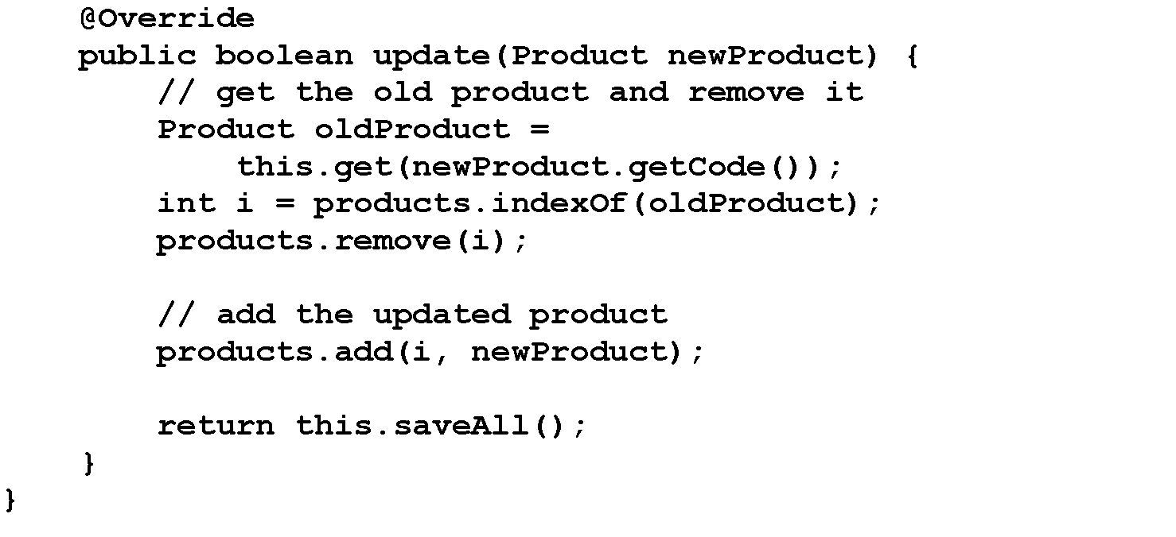
The ProductTextFile class (cont.)

Slide 38
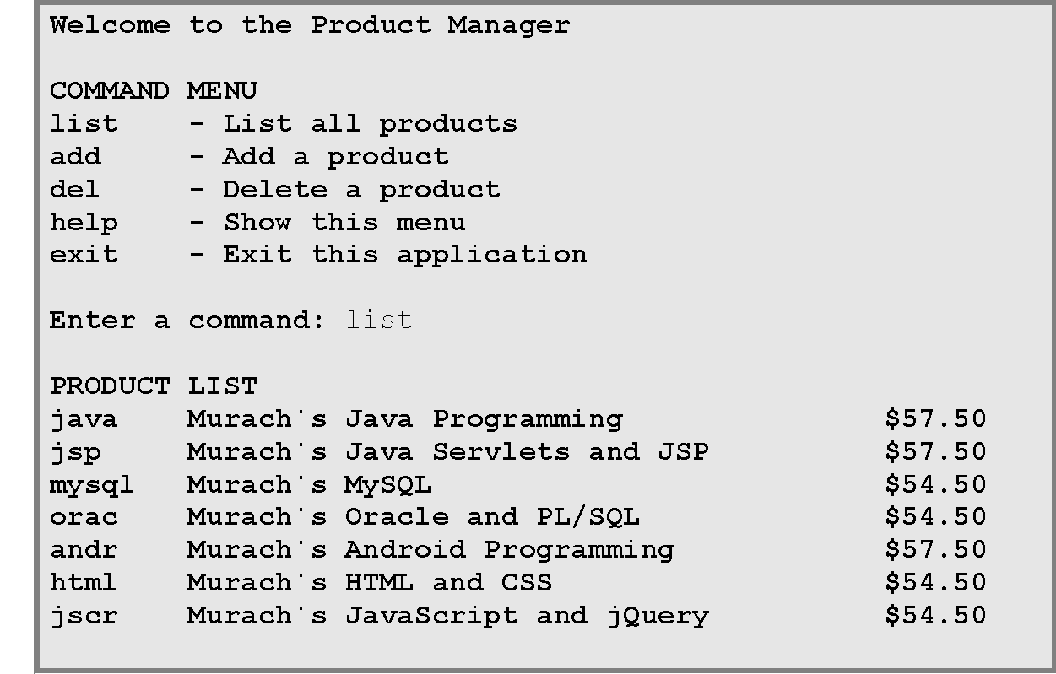
The console for the Product Manager application

Slide 39
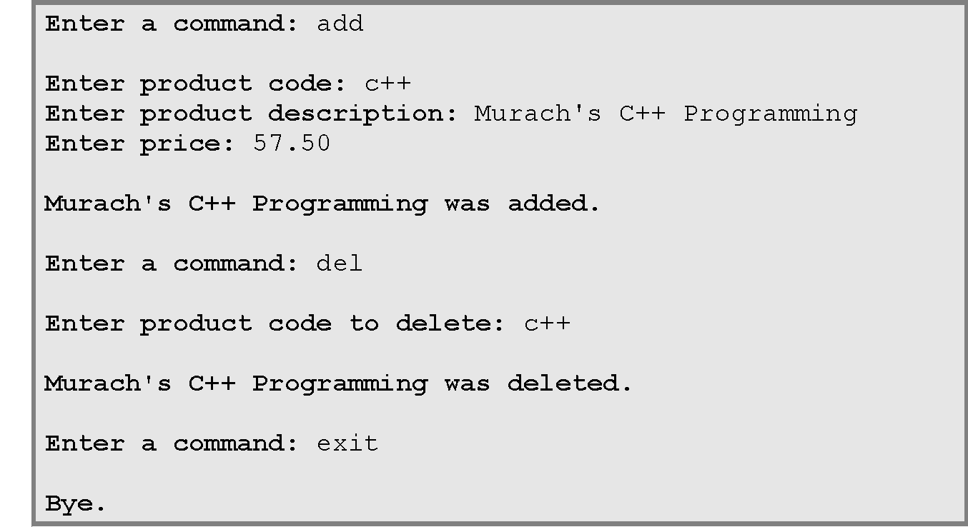
The console for the Product Manager app (cont.)

Slide 40
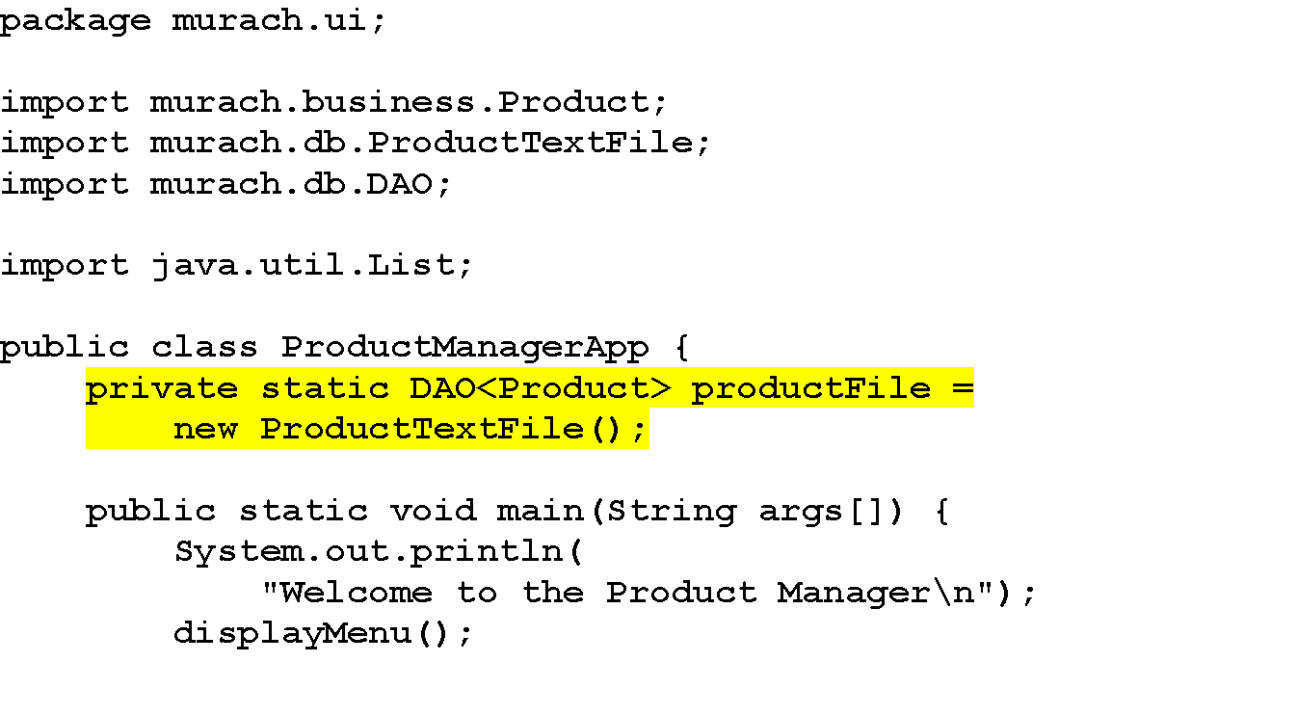
The ProductManagerApp class

Slide 41
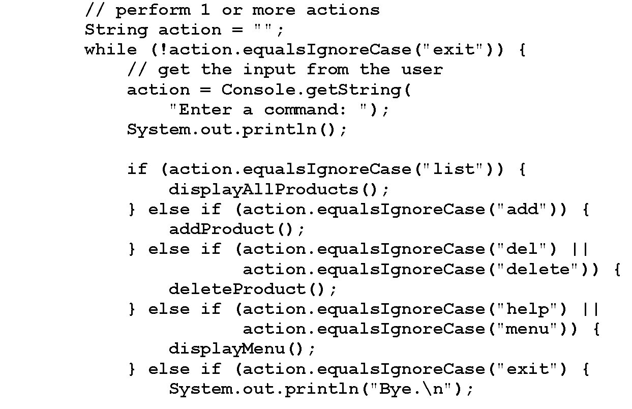
The ProductManagerApp class (cont.)

Slide 42
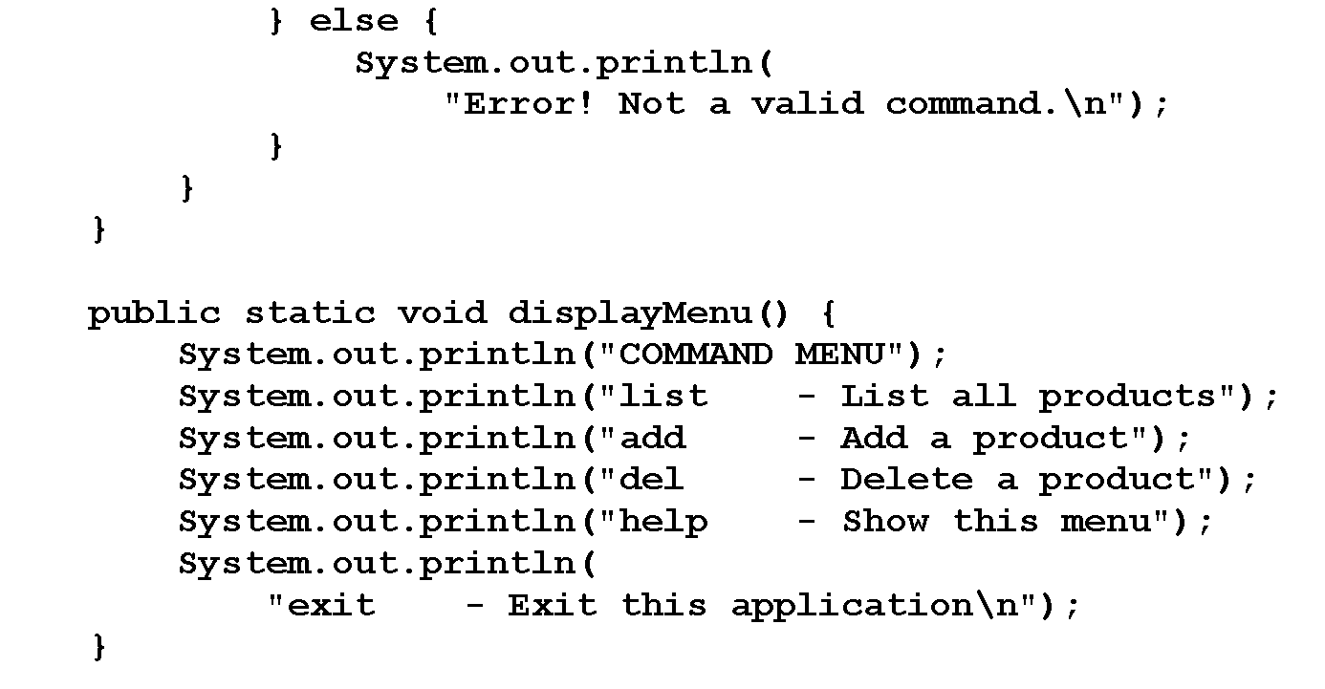
The ProductManagerApp class (cont.)

Slide 43
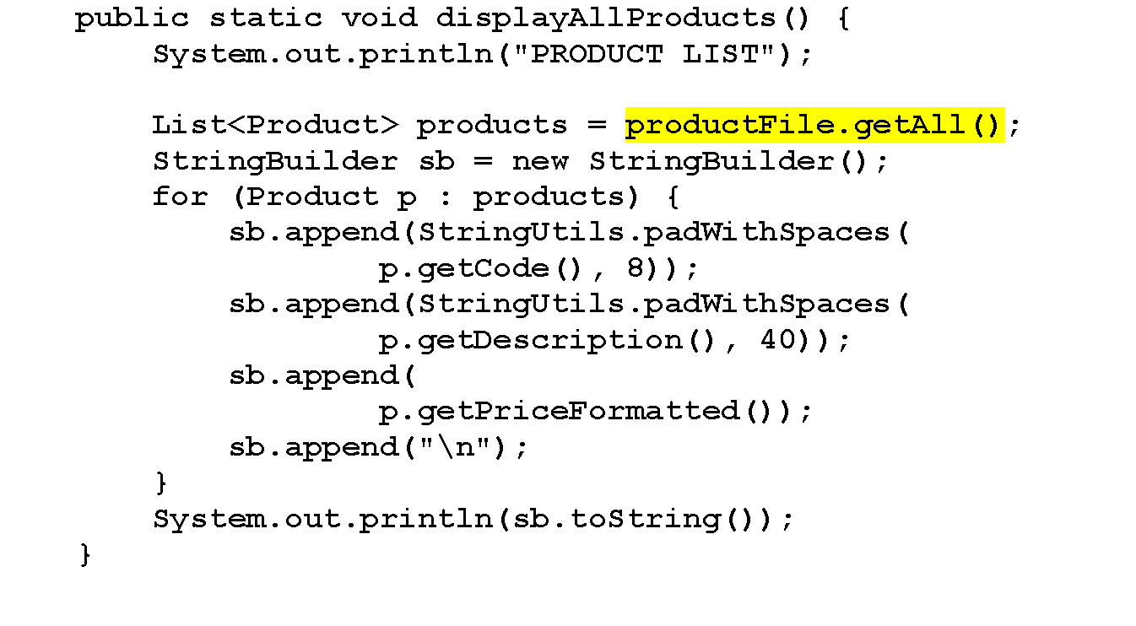
The ProductManagerApp class (cont.)

Slide 44
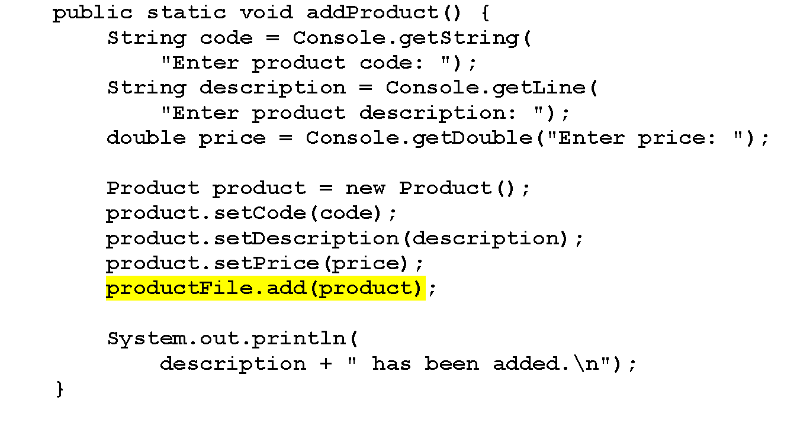
The ProductManagerApp class (cont.)

Slide 45
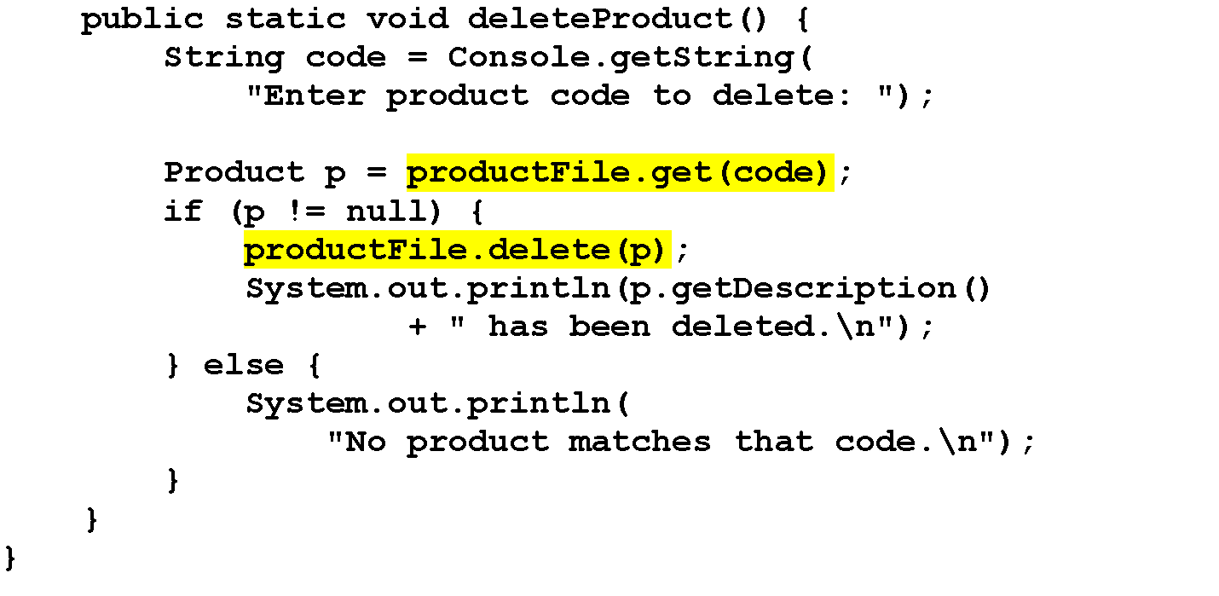
The ProductManagerApp class (cont.)

Slide 46
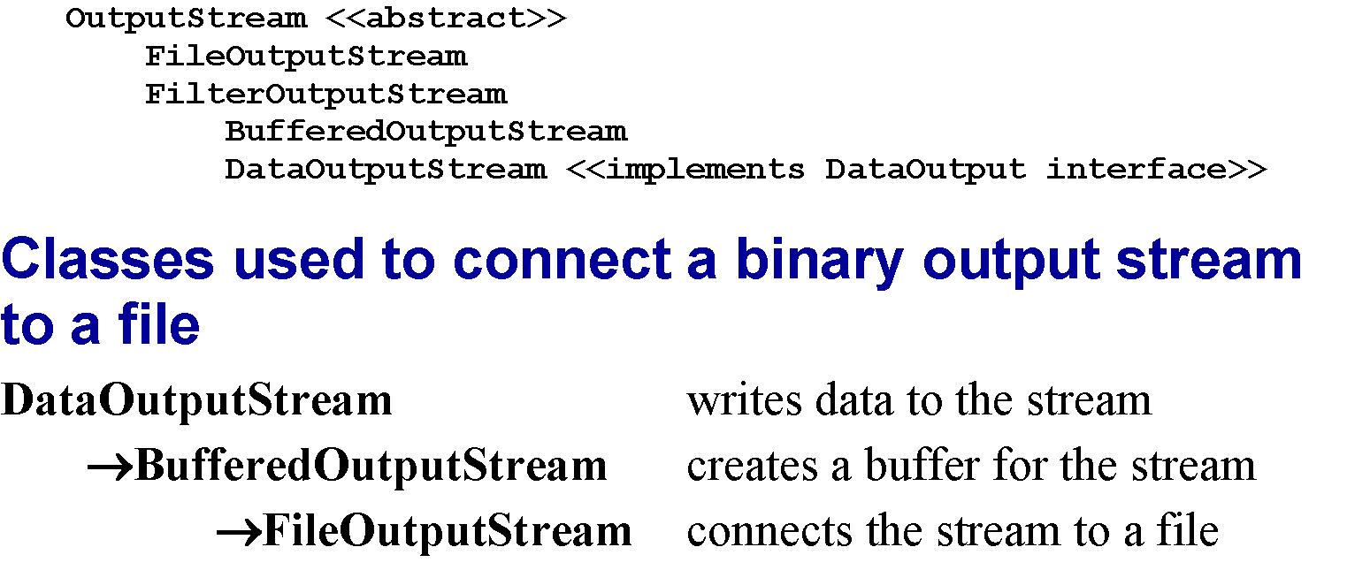
A subset of the OutputStream hierarchy

Slide 47
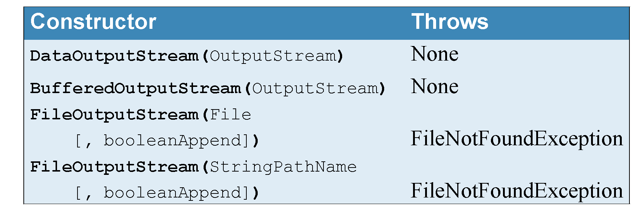
Constructors of the OutputStream hierarchy classes

Slide 48
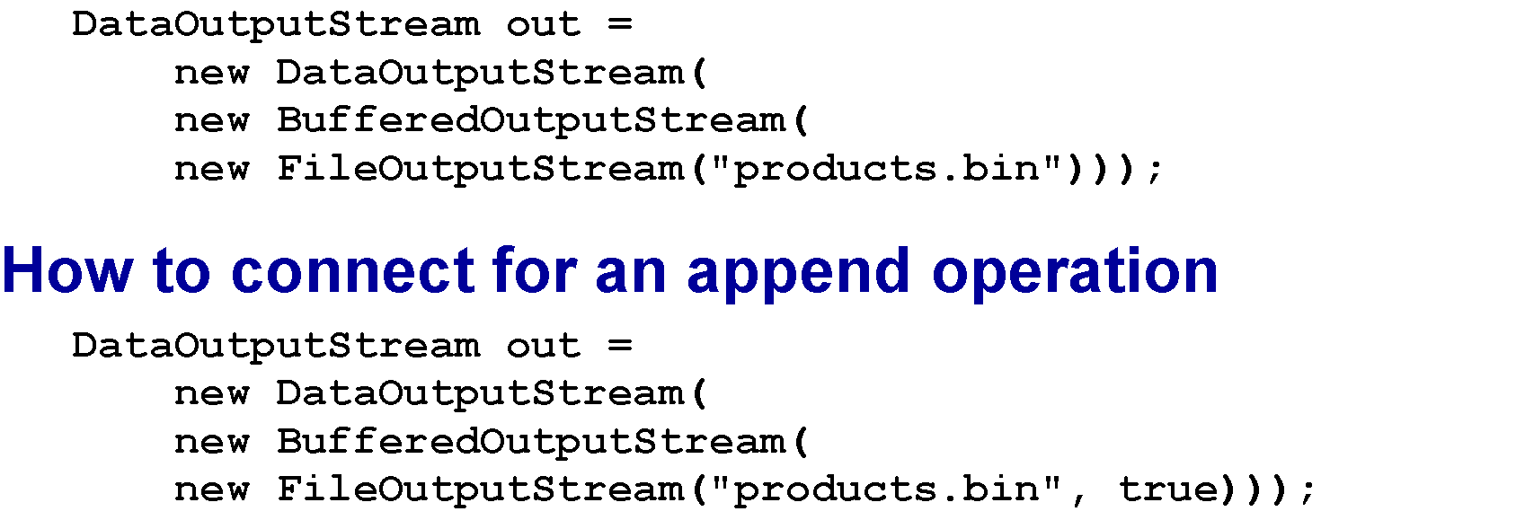
How to connect to a file with a buffer

Slide 49
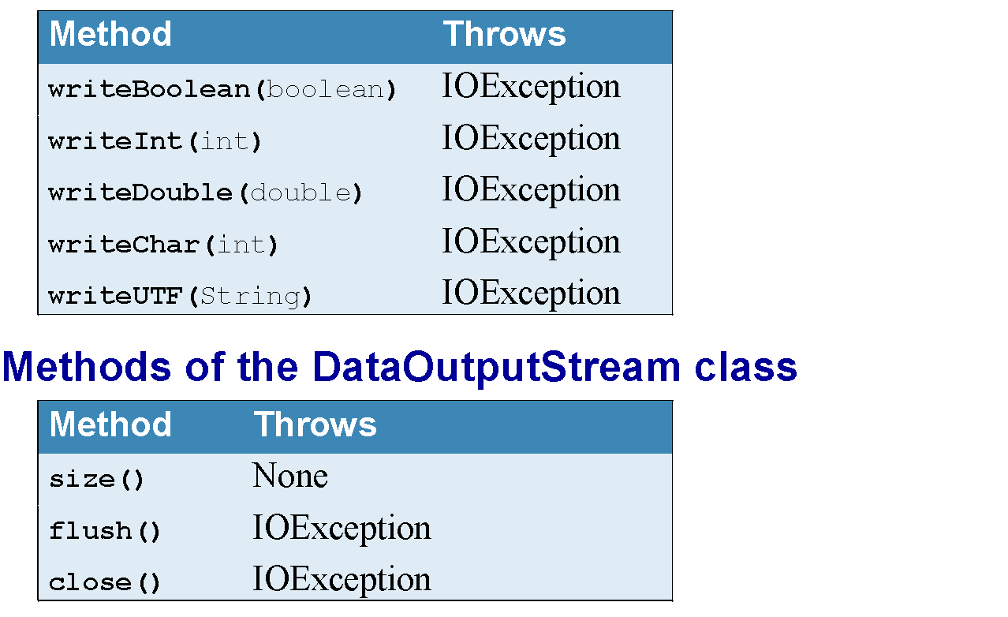
Common methods of the DataOutput interface

Slide 50
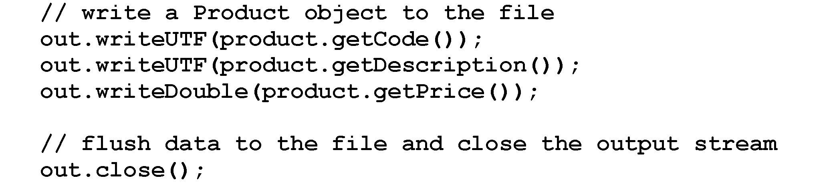
Code that writes data to a binary file

Slide 51
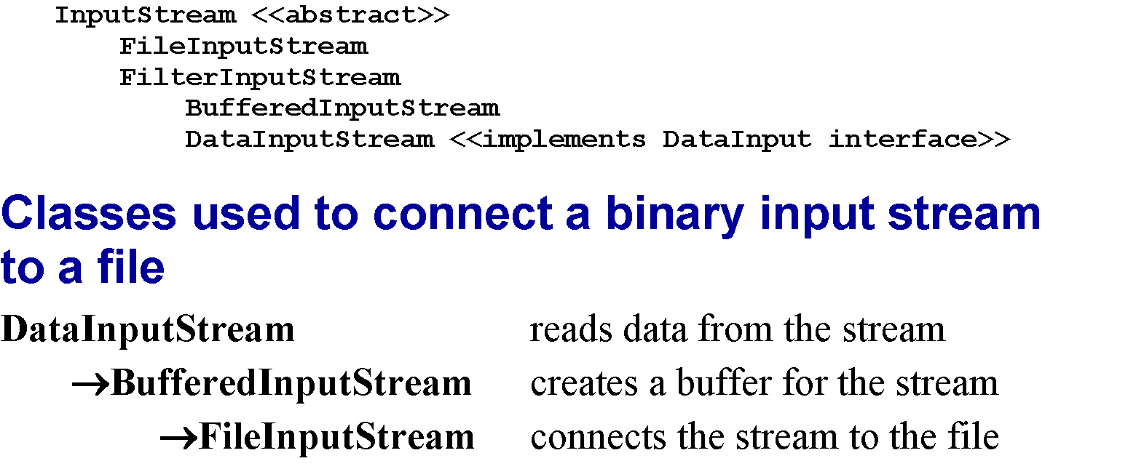
A subset of the InputStream hierarchy

Slide 52
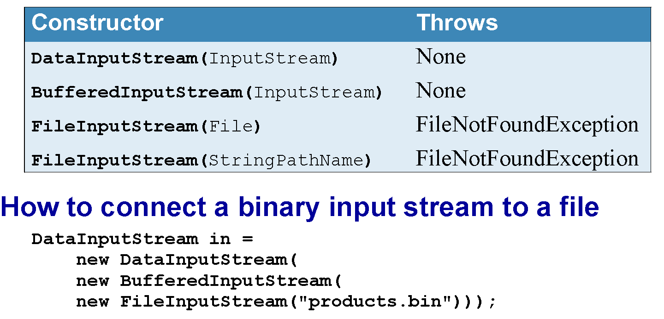
Constructors of the InputStream hierarchy classes

Slide 53

Common methods of the DataInput interface

Slide 54

Code that reads Product objects from a binary file

Slide 55

The ProductBinaryFile class

Slide 56

The ProductBinaryFile class (cont.)

Slide 57

The ProductBinaryFile class (cont.)

Slide 58

The ProductBinaryFile class (cont.)

Slide 59

The ProductBinaryFile class (cont.)

Slide 60

The ProductBinaryFile class (cont.)

